Slide 1
Eva Fashion World
Guide : Binumon joseph Vijayalakshmi M R
Assistant Professor RMCA-B
Amal Jyothi College Of Engineering, Roll No:39
Kanjirappally.

Slide 2
ABSTRACT:
The purpose of Eva Fashion World System is to automate the existing manual system by the help of computerized equipment’s and full fledged computer software, fulfilling their requirements, so that their valuable data/information can be stored for a longer period with easy accessing and manipulation of the same.The required software and hardware are easily available and easy to work with. Eva Fashion World System, as described above, can lead to error free, secure, reliable and fast management system. It can assist the user to concentrate on their other activities rather to concentrate on the record keeping. Thus it will help organization in better utilization of resources. The Organization can maintain computerized records without redundant entries. That means that one need not be distracted by information that is not relevant, while being able to reach the information.
The aim is to automate its existing manual system by the help of computerized equipment’s and full fledged computer software, fulfilling their requirement’s, so that their valuable data/information can be stored for a longer period with easy accesing and manipulation of the same. Basically the project describes how to manage for good performance and better services for the clients.
The main objective of the project on Eva Fashion world is to manage the details of boutique.The project is totally build administrative end and thus only the administrater is guaranteed the access. The purpose of the project is to build an application program to reduce the manual work for managing boutique…

Slide 3
Users
Admin
User
Boutique
Staff
1.Admin
Login
Add Boutiques
View boutiques
View feedback.
Active or Deactive Registered users.
Approve/reject Registered Boutique.
2.User
Registration
Login
View Boutiques
Apply for products
View products
Payment
Send Feedback
Edit profile

Slide 4
3.Boutique:
Add staffs
Login
View staffs
View order details
View customer feedback.
View payment
Edit profile
4. Staff
View Registered Users.
Login
View Order.
Accept Order
Dispatch
View feedback
Edit profile
Manage product details

Slide 5
Existing System
Existing system does not provide proper guidence to how to sell their products through online
The current system does not providing helpdesk to learn basics of how to register into sites, sell crops and transactions
The current system does not provide websites to customers in their local languages
proposed system
The proposed system is defined to meets all the disadvantages of the existing system. It is necessary to have a system that is more user friendly and user attractive for bussiness growth. This project is developing using Php and MySQL. On such consideration the system is proposed. In our proposed system there is an admin who can view and manage all the registered users. It allows customers to make their orders and do their transactions by using online payment method. Advantages of proposed system .The system is very simple in design and to implement. The system requires very low system resources and the system will work in almost all configurations. It has got following features:
Low Cost- Low cost is spend due to the reduced manual work, no paper cost.
Better security- For data to remain secure measures must be taken to prevent unauthorized access. Security means that data are protected from various forms of destruction. The system security problem can be divided into four related issues: security, integrity, privacy and confidentiality. Username and password requirement to sign in ensures security. It will also provide data security as we are using the secured databases for maintaining the documents.
Ensure data accuracy- The proposed system eliminates the manual errors while entering the details of the users during the registration.
Better service - The product will avoid the burden of hard copy storage. We can also conserve the time and human resources for doing the same task. The data can be maintained for longer period with no loss of data.
Accessibility- The registered users can login to the site at any time anywhere and can access the updated information properly.
Minimum time required- The customers can view products in different ways like category, type or can view by directly searching a product name which helps to purchase a product with minimum time.

Slide 6
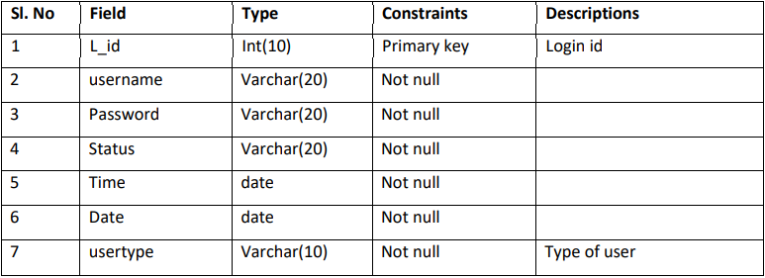
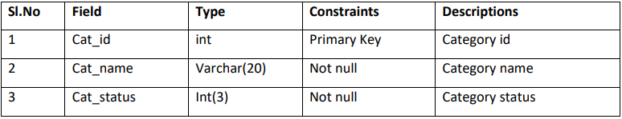
Table design
Table Name: tbl_login
Primary Key: L_id
2. Table Name: tbl_category
Primary key: Cat_id

Slide 7
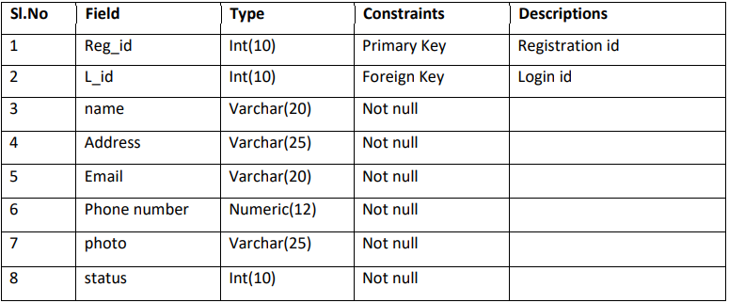
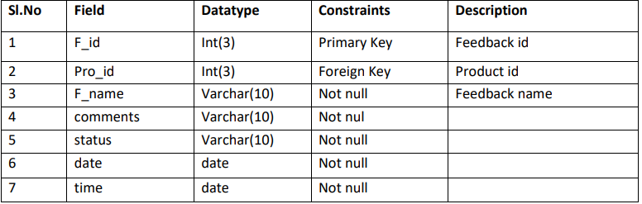
3.Table Name: tbl_Registeration(user)
Primary Key: reg_id
Foreign key: L_id
4. Table Name: tbl_Feedback
Primary Key: f_id
Foreign Key: Pro_id

Slide 8
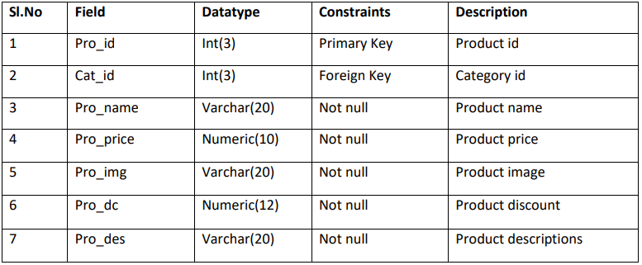
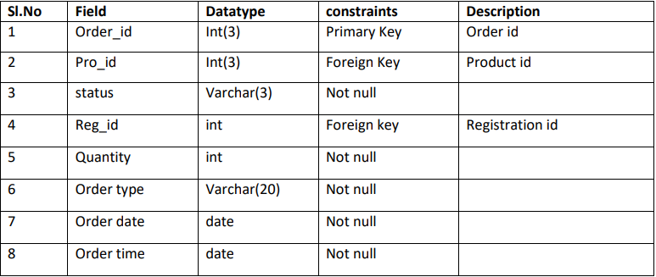
5.Table Name: Pro_Details (product details)
Primary key: Pro_id
Foreign Key: cat_id
6. Table Name: tbl_order details
Primary Key: Order_id
Foreign Key: pro_id

Slide 9
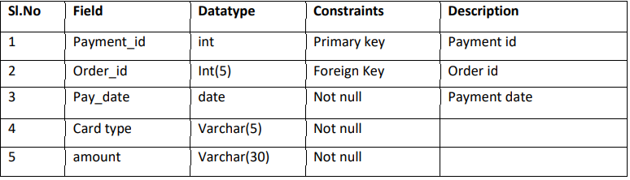
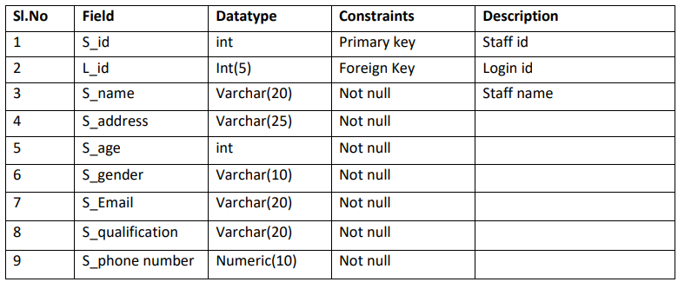
7.Table name: tbl_payment
Primary Key: payment_id
Foreign Key: order_id
8. Table name: tbl_staffreg (staff registration)
Primary Key: S_id
Foreign key: L_id

Slide 10
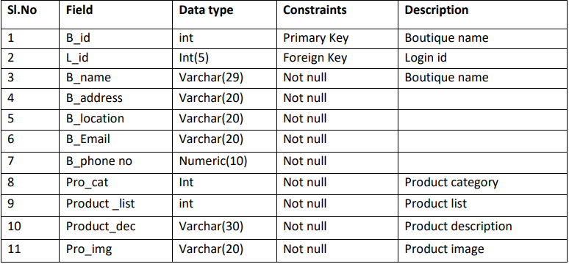
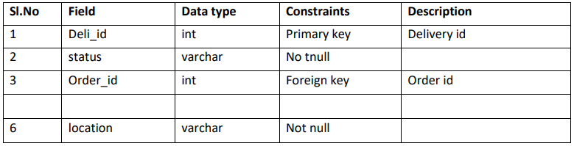
8.Table name: tbl_boutique reg
Primary key: B_id
Foreign Key: L_id
9.Table name: tbl_Delivery
Primary key: Deli_id
Foreign key: order_id

Slide 11
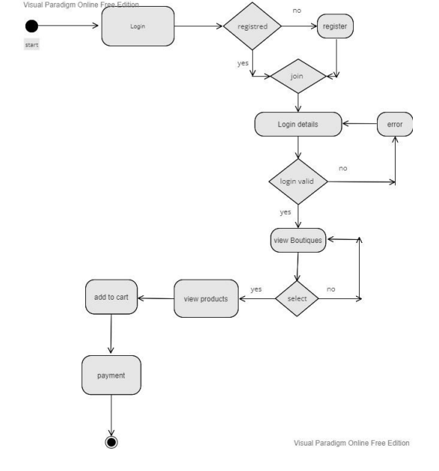
UML-Diagrams
1.Activity Diagram.

Slide 12
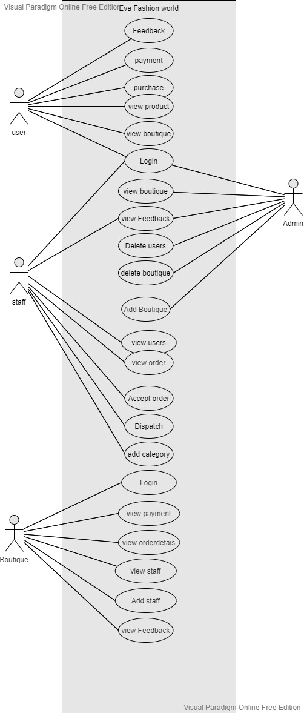
2.Usecase Diagram

Slide 13
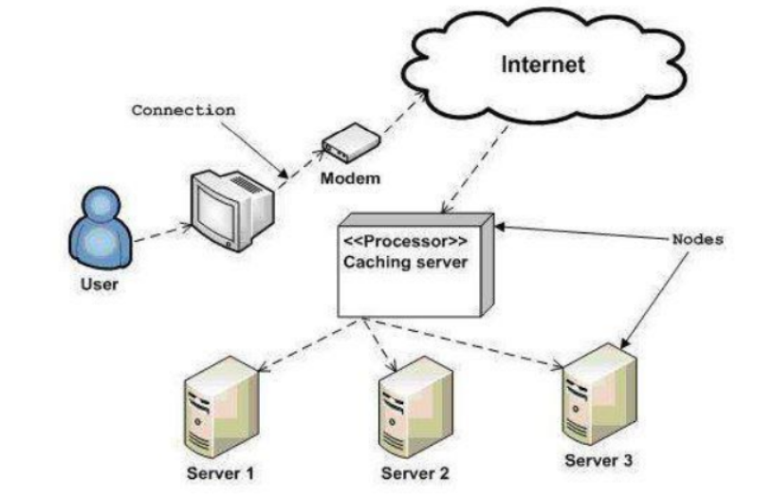
3.Deployement Diagram

Slide 14
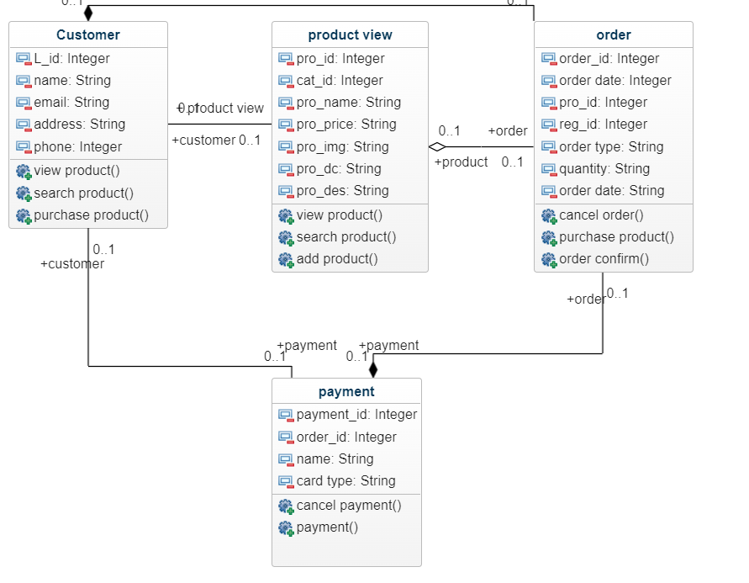
4. Class Diagram

Slide 15
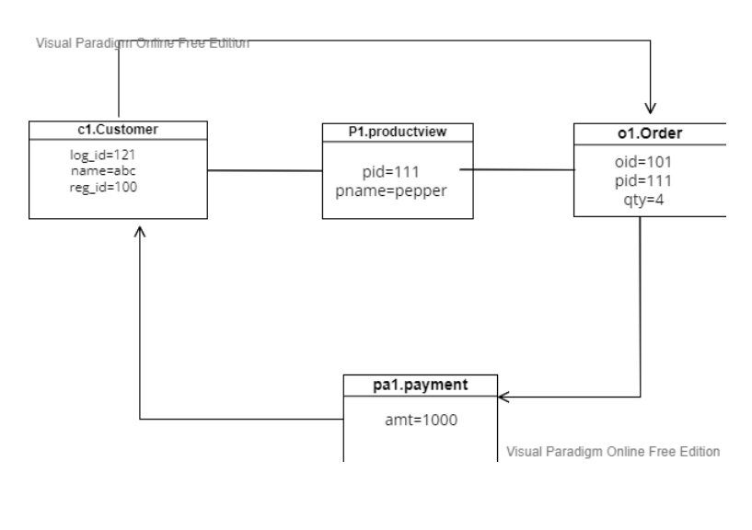
5.Object Diagram.

Slide 16
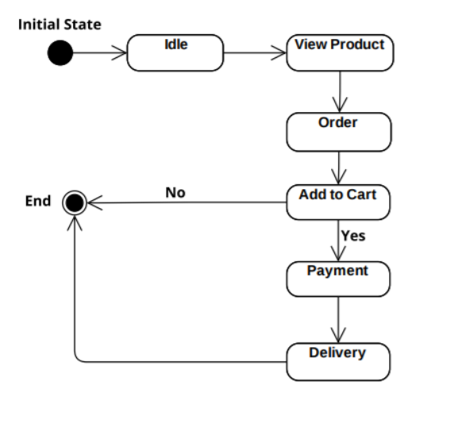
6.State Diagram.

Slide 17
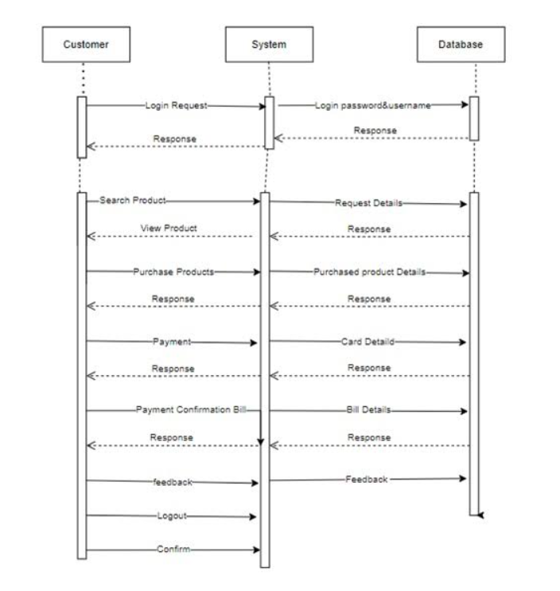
7.Sequence Diagram.

Slide 18
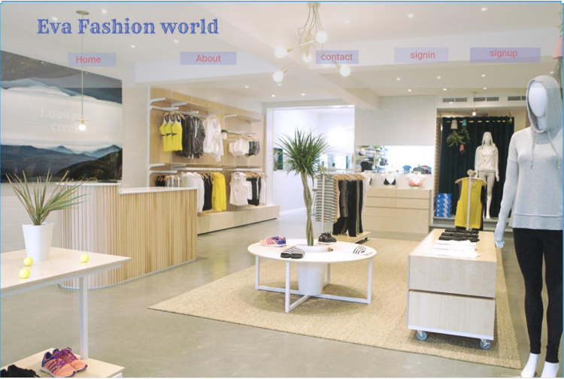
Prototype design using Figma
1.Home Page

Slide 19
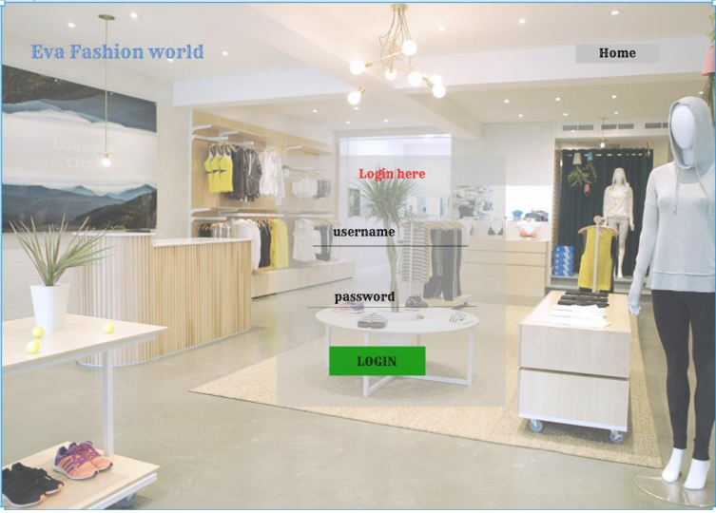
2.Login page

Slide 20
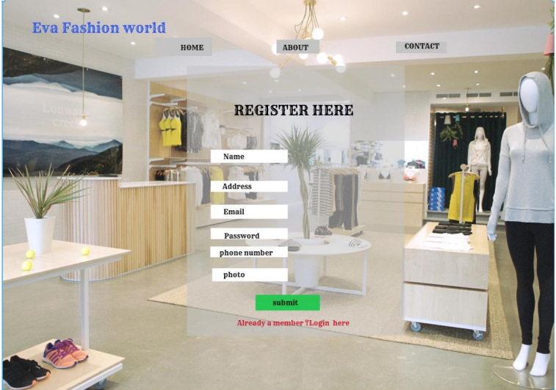
3.Registration Page

